Slide 1
Bike Thefts in Berlin
M.Cem Akuras

Slide 2
TABLE OF CONTENTS
01.
02.
03.
Introduction
Dataset Description
Data Understanding
04.
05.
06.
Data Preparation
Key Findings
Next Steps

Slide 3



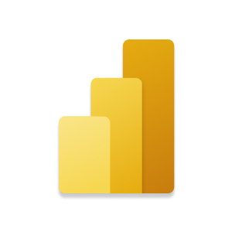


INTRODUCTION
Objective: Exploration and analysis of bike theft data in Berlin.
Data Sources:
Primary Dataset: Contains detailed records of bike thefts in Berlin.
Auxiliary Dataset: Includes district numbers and district names to enhance the analysis.
Tools Used:
Python
VS Code
Jupyter Notebook
Power BI
Tableau
Git Bash

Slide 4
DATASET DESCRIPTION
11 columns
22127 rows
2 columns
12
rows
fahrraddiebstahl
berlin_districts
Records of Theft
Berlin Districts
Crime Start & End Time
LOR
bezirk_id
bezirk_name
Type of Bicycle
Amount of Damage
fahrraddiebstahl_berlin

Slide 5
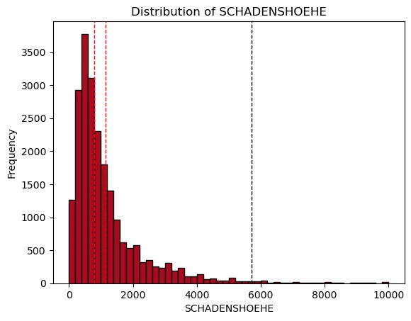
DATA UNDERSTANDING
16 columns
22127 rows
50
Duplicate Records
fahrraddiebstahl_berlin
0 Missing Value
221
Outliers
4 Integer
12 Object

Slide 6
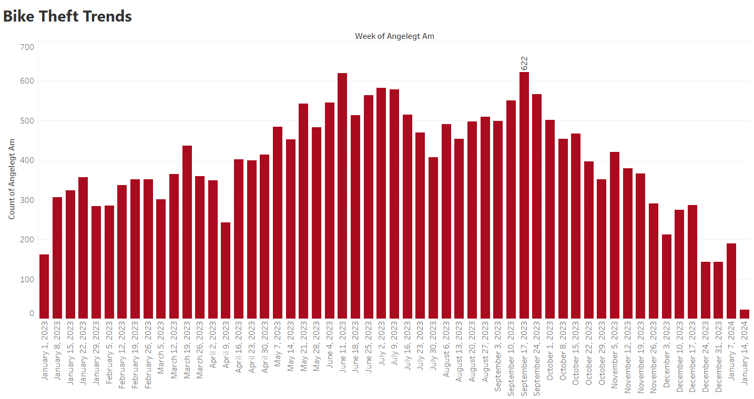
DATA UNDERSTANDING
Seasonal trend,
Peaks typically occurring in the warmer months.

Slide 7
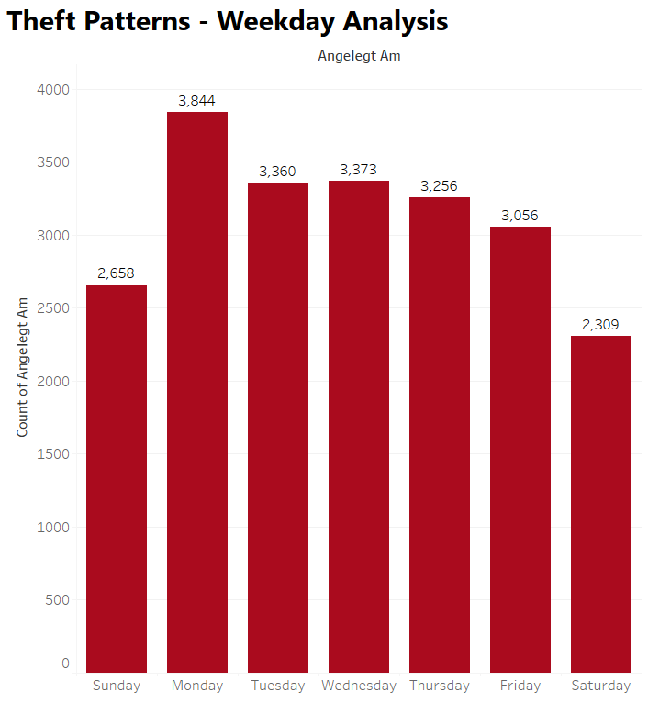
DATA UNDERSTANDING
Most frequent on Mondays,
Lowest point on Saturdays.

Slide 8
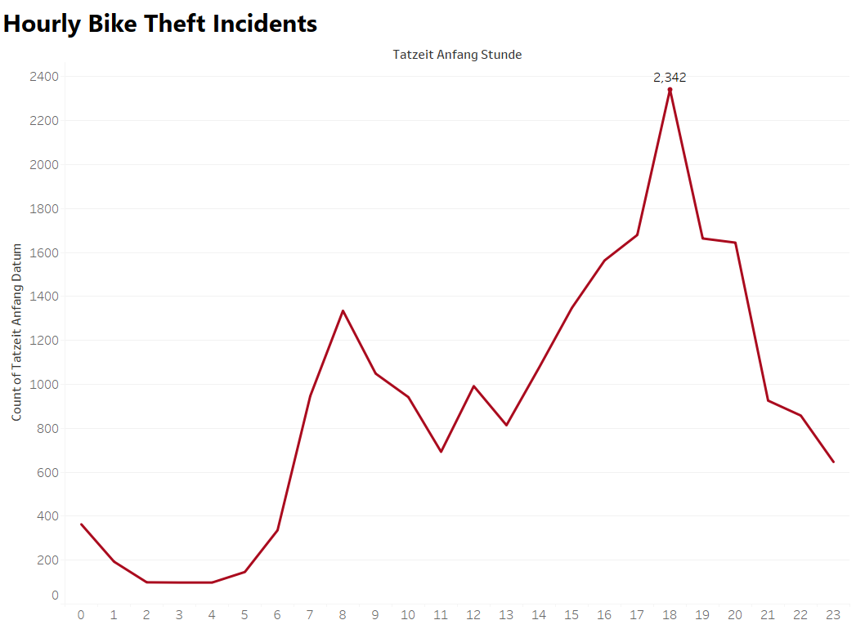
DATA UNDERSTANDING
Morning peak occurs at 8 AM and evening peak occurs at 6 PM,
A sharp increase in bike thefts during evening hours.

Slide 9
DATA UNDERSTANDING
Bike Thefts by District
Pankow
2,759
Mitte, Friedrichshain-Kreuzberg and Pankow districts experience the highest number of bike thefts.
Mitte
3,217
Friedrichshain-Kreuzberg
3,167

Slide 10
DATA PREPARATION
Reducing Dimensionality
fahrraddiebstahl_berlin
Shape
(22127, 16)
Shape
(21856, 14)
Handling Duplicate Records
Removed 50 Duplicates
Handling Outliers
Removed 221 Outliers
Handling Errors
Corrected 3 Errors
Transforming Data Types
Date Time, Categorical

Slide 11

KEY FINDINGS
Trend Analysis
2nd and 3rd quarter have seasonal trends in bike thefts.
WHY? To support in predictive planning for theft prevention.
Theft Time Pattern
08:00 and 18:00 are peak hours for theft incidents.
WHY? To highlight critical times for security measures.
High-Risk Locations
Mitte, Friedrichshain-Kreuzberg and Pankow have highest theft rates.
WHY? To show districts that need bike-safe infrastructure.

Slide 12




NEXT STEPS
What can be next steps?
Improving analysis with additional data:
Socioeconomic Data
CCTV Coverage Data
Police Patrol Routes
Public Lighting Information
Bicycle Parking Facilities
Designing a daily data update pipeline:
Data Ingestion by Python
Data Processing by Python
Data Storage by PostgreSQL
Data Visualization by
Power BI

Slide 13


Thank you! M.Cem Akuras
mcakuras@gmail.com
www.linkedin.com/in/mcemakuras

